Slide 1

Physics Laboratory (PH-111)
Presentation For
Presented by
Group-16
Abhishek Das (1912156)
Prottay kumar (1912157)
Sourabh Shah (1912158)
Saurabh Sinha (1912159)
Subhojit ghimIre (1912160)

Slide 2
AIM of the Presentation
To Study the charging and discharging of a capacitor
To measure the time constant characterizing charging/discharging process and compare the experimental RC time constant with theoretical RC time constant.

Slide 3
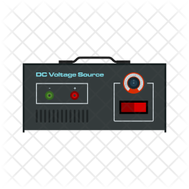
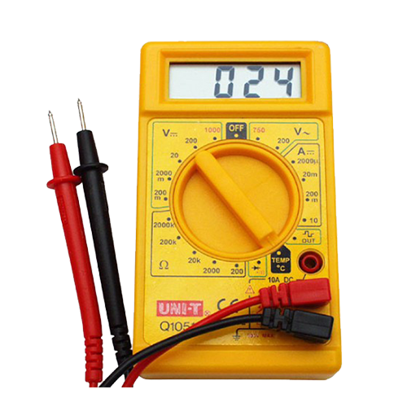
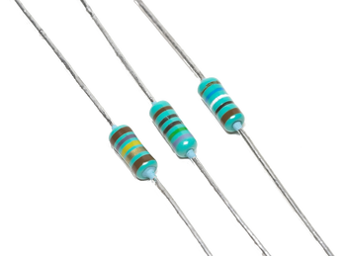
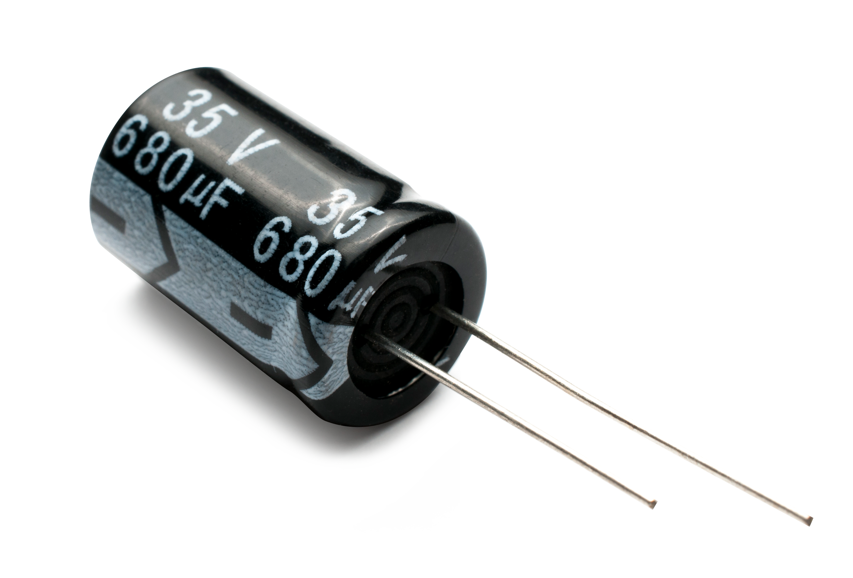
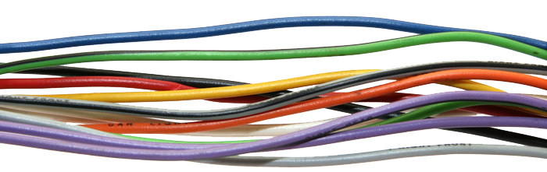
Apparatus USED
DC Voltage
Source (12V)
Resistors
Digital Multi-meter
Capacitor
Connecting Wire

Slide 4
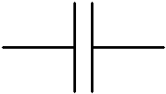
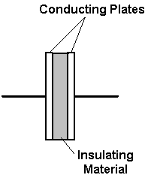
Capacitor ( )
A Capacitor is a passive device that stores energy in its Electric Field and returns energy to the circuit whenever required.
A Capacitor consists of two Conducting Plates separated by an Insulating Material or Dielectric.
When a Capacitor is connected to a circuit with Direct Current (DC) source, "charging" and "discharging" the Capacitor, will happen in specific conditions.
Fig: Basic structure of the Capacitor

Slide 5
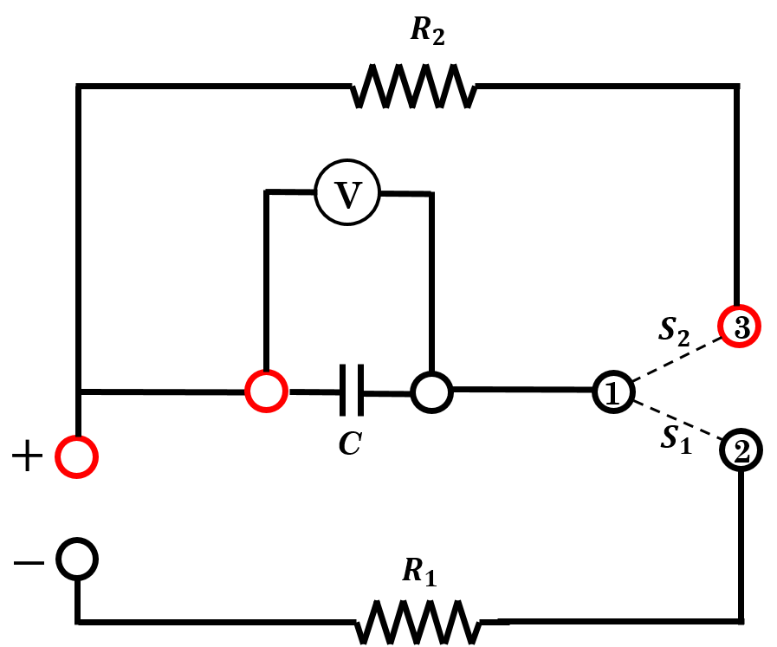
Circuit Working
If S₁ is closed (by connecting terminal 1 to terminal 2) keeping S₂ open, then the battery charges the capacitor and current flows through the resistor R₁ until the capacitor is fully charged. Once the capacitor is fully charged then the current i through the resistor become zero
If the switch S₁ is opened (by disconnecting terminal 1 to terminal 2) and S₂ is closed (by connecting terminal 1 to terminal 3) the charge in the capacitor discharges through the resistor R₂.
Fig: Circuit Diagram
Resistor (R1) = 276 K Ω
Resistor (R2) = 150 K Ω
Capacitor (C) = 2200 μF
DC supply = 4V
Voltmeter (V)

Slide 6

While Charging
Voltage across the capacitor V = q/C and the current through R₁
I = dq/dt,
where q(t) = charge on the capacitor at time t.
By applying Kirchoff’s second law,$iR_{1}+ \frac{q}{C}=ε$ ---(1) , $R_{1}\frac{dq}{dt}+ \frac{q}{C}=ε$
Which has the solution, $q\left(t\right)=Cε\left(1−e^{−\frac{t}{R_{1}C}}\right)=q_{0}\left(1−e^{−\frac{t}{R_{1}C}}\right)=q_{0}\left(1−e^{−\frac{t}{τ}}\right)$ - (2)
Where, $q_{0}= Cε$ and$τ=R_{1}C$.
The quantity $τ=R_{1}C$is the charging time constant which characterizes the rate at which charge is deposited on the capacitor.
As $t → ∞$, equation (2) shows that $q→Cε=q_{0}$. In practice the capacitor charges to its maximum value $q_{0}$(asymptotically) after a time interval equal to a few time constants.

Slide 7

While Discharging
Discharges through the resistor R₂.
By Kirchoff’s second law,
$R_{2}\left(\frac{dq}{dt}\right)+ \left(\frac{q}{c}\right)=0$,
with the solution (taking $q=q_{0}$ at t=0)
$$q\left(t\right)=q_{0}e^{− \frac{t}{R_{2}C}}$$
The charge on the capacitor decays exponentially with time.
After a time $t=R_{2}C$ (equal to the discharging time constant) the charge drops from it’s initial value $q_{0}$by a factor of $e^{−1}$.

Slide 8
PROCEDURE
The circuit was set as shown in the circuit diagram.
To charge the capacitor, the circuit S₁ was closed, and S₂ was kept open.
The readings of voltmeter V (in V) were noted alongside the time t (in sec) and charge Q (in µC) with every time interval of 30 seconds, until the voltmeter readings were maxed at an unchanged voltage value.
The graph for Charge Q vs Time t was plotted for the readings of charging of the capacitor.
To read the discharging of the capacitor, the circuit S₂ was closed and S₁ was opened.
Similar to the charging, the readings of the voltmeter V (in V) alongside the time t (in sec) and charge Q (in µC) with every time interval of 30 seconds, until the voltmeter readings dropped down to the minimum unchanged voltage value.
The graph for Charge Q and Time t was plotted for the readings of discharging of the capacitor.
Time Constant for both charging and discharging of the capacitor was calculated using the noted theoretical readings and compared with the graphically plotted values.

Slide 9

OBSERVEATION
From the given apparatus,
$$R_{1}=276 k\text{Ω}$$
$$R_{2}=150 \text{k}\text{Ω}$$
C$=\text{2200 }\text{µ}\text{F}$

Slide 10
OBSERVEATION
 | Voltage, V (in V) | Charge, Q (in C) | Charging time, t (in s)
 | 0.220 | 484.0 | 30
 | 0.410 | 902.0 | 60
 | 0.600 | 1320.0 | 90
 | 0.780 | 1716.0 | 120
 | 0.950 | 2090.0 | 150
 | 1.128 | 2481.6 | 180
 | 1.272 | 2798.4 | 210
 | 1.420 | 3124.0 | 240
 | 1.551 | 3412.2 | 270
 | 1.680 | 3696.0 | 300
 | 1.801 | 3952.2 | 330
 | 1.919 | 4221.8 | 360
 | 2.031 | 4468.2 | 390
 | 2.136 | 4699.2 | 420
 | 2.238 | 4923.6 | 450
 | 2.331 | 5128.2 | 480
 | 2.423 | 5330.6 | 510
 | 2.510 | 5522.0 | 540
 | 2.588 | 5693.6 | 570
 | 2.667 | 5774.04 | 600
For charging capacitor

Slide 11
OBSERVEATION
 | Voltage, V (in V) | Charge, Q (in C) | Charging time, t (in s)
 | 2.748 | 6032.4 | 630
 | 2.814 | 6190.8 | 660
 | 2.880 | 6336.0 | 690
 | 2.945 | 6479.0 | 720
 | 3.005 | 6661.0 | 750
 | 3.064 | 6740.8 | 780
 | 3.119 | 6861.8 | 810
 | 3.172 | 6978.4 | 840
 | 3.222 | 7088.4 | 870
 | 3.269 | 7191.8 | 900
 | 3.316 | 7295.2 | 930
 | 3.358 | 7387.6 | 960
 | 3.392 | 7462.4 | 990
 | 3.439 | 7565.8 | 1020
 | 3.471 | 7636.2 | 1050
 | 3.512 | 7726.4 | 1080
 | 3.581 | 7878.2 | 1110
 | 3.612 | 7946.4 | 1140
 | 3.642 | 8012.4 | 1170
 | 3.669 | 8071.8 | 1200
For charging capacitor

Slide 12
OBSERVEATION
 | Voltage, V (in V) | Charge, Q (in C) | Charging time, t (in s)
 | 3.696 | 8131.2 | 1230
 | 3.721 | 8186.2 | 1260
 | 3.745 | 8239.0 | 1290
 | 3.768 | 8289.6 | 1320
 | 3.791 | 8340.2 | 1350
 | 3.812 | 8386.4 | 1380
 | 3.832 | 8430.4 | 1410
 | 3.851 | 8472.0 | 1440
 | 3.870 | 8514.4 | 1470
 | 3.887 | 8551.8 | 1500
 | 3.904 | 8588.8 | 1530
 | 3.919 | 8621.0 | 1560
 | 3.935 | 8657.0 | 1590
 | 3.950 | 8690.6 | 1620
 | 3.963 | 8718.6 | 1650
 | 3.976 | 8747.2 | 1680
 | 3.988 | 8773.6 | 1710
 | 4.000 | 8800.0 | 1740
 | 4.014 | 8830.8 | 1770
 | 4.025 | 8855.0 | 1800
For charging capacitor

Slide 13
OBSERVEATION
 | Voltage, V (in V) | Charge, Q (in C) | Charging time, t (in s)
 | 4.036 | 8879.2 | 1830
 | 4.045 | 8899.0 | 1860
 | 4.054 | 8918.8 | 1890
 | 4.063 | 8938.6 | 1920
 | 4.072 | 8958.4 | 1950
 | 4.079 | 8973.8 | 1980
 | 4.088 | 8999.6 | 2010
 | 4.094 | 9006.8 | 2040
 | 4.102 | 9024.4 | 2070
 | 4.108 | 9037.6 | 2100
 | 4.115 | 9053.0 | 2130
 | 4.121 | 9066.2 | 2160
 | 4.127 | 9079.4 | 2190
 | 4.132 | 9090.4 | 2220
 | 4.138 | 9103.6 | 2250
 | 4.145 | 9119.0 | 2280
 | 4.148 | 9125.6 | 2310
 | 4.152 | 9.134.4 | 2340
 | 4.152 | 9.134.4 | 2370
 | 4.152 | 9.134.4 | 2400
For charging capacitor

Slide 14
OBSERVEATION
 | Voltage, V (in V) | Charge, Q (in C) | Discharging time, t (in s)
 | 4.152 | 9134.4 | 0
 | 4.150 | 9130.0 | 30
 | 3.7425 | 8239.0 | 60
 | 3.420 | 7524.0 | 90
 | 3.310 | 7282.0 | 120
 | 2.866 | 6305.0 | 150
 | 2.622 | 5768.4 | 180
 | 2.399 | 5277.8 | 210
 | 2.134 | 4826.8 | 240
 | 2.011 | 4424.2 | 270
 | 1.841 | 4050.2 | 300
 | 1.690 | 3418.0 | 330
 | 1.545 | 3399.0 | 360
 | 1.416 | 3115.2 | 390
 | 1.299 | 2857.8 | 420
 | 1.184 | 2604.8 | 450
 | 1.090 | 2398.0 | 480
 | 1.000 | 2200.0 | 510
 | 0.917 | 2017.4 | 540
 | 0.842 | 1852.4 | 570
For discharging capacitor

Slide 15
OBSERVEATION
 | Voltage, V (in V) | Charge, Q (in C) | Discharging time, t (in s)
 | 0.772 | 1698.4 | 600
 | 0.707 | 1555.4 | 630
 | 0.648 | 1425.6 | 660
 | 0.594 | 1306.8 | 690
 | 0.545 | 1199.0 | 720
 | 0.503 | 1106.6 | 750
 | 0.461 | 1014.2 | 780
 | 0.424 | 932.8 | 810
 | 0.389 | 855.8 | 840
 | 0.358 | 787.6 | 870
 | 0.329 | 723.8 | 900
 | 0.302 | 664.4 | 930
 | 0.278 | 611.6 | 960
 | 0.254 | 558.8 | 990
 | 0.235 | 517.0 | 1020
 | 0.217 | 477.4 | 1050
 | 0.200 | 440.0 | 1080
 | 0.183 | 402.6 | 1110
 | 0.169 | 371.8 | 1140
 | 0.159 | 349.8 | 1170
For discharging capacitor

Slide 16
OBSERVEATION
 | Voltage, V (in V) | Charge, Q (in C) | Discharging time, t (in s)
 | 0.156 | 343.2 | 1200
 | 0.143 | 314.6 | 1230
 | 0.131 | 288.2 | 1260
 | 0.121 | 266.2 | 1290
 | 0.112 | 246.4 | 1320
 | 0.105 | 231.0 | 1350
 | 0.097 | 213.4 | 1380
 | 0.089 | 195.8 | 1410
 | 0.082 | 180.4 | 1440
 | 0.076 | 167.2 | 1470
 | 0.072 | 158.4 | 1500
 | 0.076 | 167.2 | 1530
 | 0.064 | 140.8 | 1560
 | 0.064 | 140.8 | 1590
 | 0.064 | 140.8 | 1620
For discharging capacitor

Slide 17
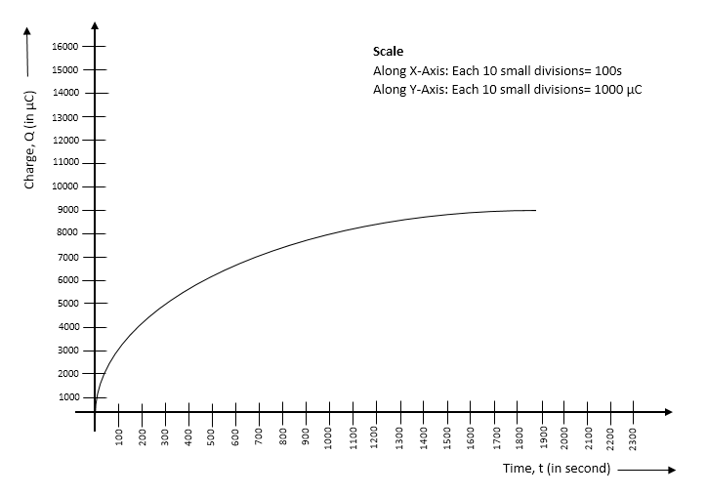
Fig: Graph for charging

Slide 18
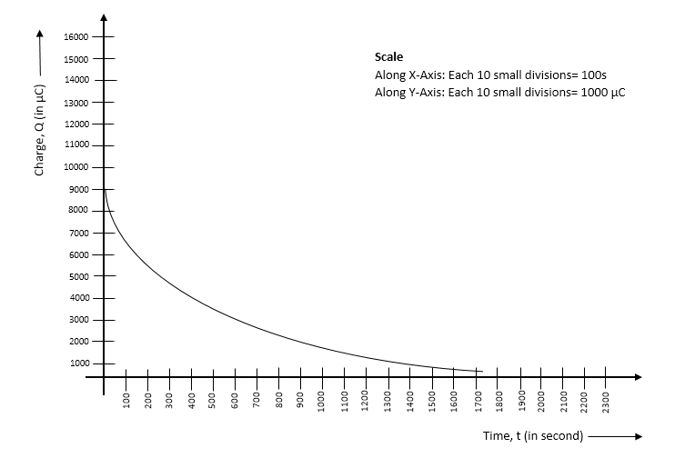
Fig: Graph for discharging

Slide 19

Calculation
Time constant for given combination:
Theoretical value, charging, ${\text{z}=R_{1}C=276×2200× 10}^{−3}=607.200 s$
Theoretical value, discharging, ${\text{z}=R_{2}C=150×2200× 10}^{−3}=330.200 s$
For charging, at t = τ1.
Charge, $q=q_{0}( 1−\frac{1}{e} )=9134.4×0.632=5774.04 μC$
From the graph, we observe that our practical value.
At t= 600 sec, error= $\frac{607.2−600}{607.2}×100\%=1.18\%$
For discharging, at t = τ2.
Charge, $q=q_{0}( \frac{1}{e} )=9134.4×0.367=3360.35 μC$
From the graph, we observe that our practical value.
At t= 335 sec, error= $\frac{335−330}{330}×100\%=1.51\%$

Slide 20

CONCLUSIONS
Hence the charging and discharging was studied by the help of the data obtained experimentally which were shown above.
The time constant characterizing charging of capacitor was found to be at t = 600 s practically and t=$607.200 s$ theoritically.
The time constant characterizing discharging of capacitor was found to be at t = 335 s practically and t=330$s$ theoritically.

Slide 21
PRECAUTIONS
The readings are to be taken carefully and accurately after every 30 seconds.
Discharging of the capacitor should be done immediately after charging.
Apparatus must be used carefully and handled with care.
Connections should be checked before giving the power supply.

Slide 22
THANK YOU

